Slide 1

Social connections with COVID-19-affected areas increase compliance with mobility restrictions
Ben Charoenwong
NUS Business School
Alan Kwan
Hong Kong University
Vesa Pursiainen
Hong Kong University &
University of Zurich

Slide 2
As of April 24
Source: https://www.ft.com/coronavirus-latest. Accessed April 24, 2020

Slide 3
As of April 24
Our Sample: February 1 – March 31, 2020
Source: https://www.ft.com/coronavirus-latest. Accessed April 24, 2020

Slide 4
Introduction
Premise:
Almost every state has implemented some mobility restriction.
Mobility restrictions are important for mitigating the spread of COVID-19
Local governments do not or cannot enforce mobility restrictions and must rely on compliance
Research Question: Do social connections between people in America and those in Italy and China increase compliance with mobility restrictions?
Finding: Social connections increase compliance of mobility restrictions by around 50%.
  1 SD increase in foreign social connections increase the effect of mobility restrictions by 84% in majority Democrat counties and 105% for Republican counties
  “Cross-cultural” connections increase the effects of social connections by 14-100%

Slide 5
Why would social connections impact social distancing compliance?
Information Flow
Biased Beliefs
Risk Exposure
Social connections are a proxy for travel
International friends share experiences from Italy and China
Homophily (e.g. political leanings), assortive matching among social connections
More travel → higher risk → more social distancing when asked to
So maybe don’t believe foreigners in your social network → less social distancing when asked to
Get more relevant information from people you “like” that can breaks the echo chamber of misinformation
1
2
3

Slide 6
Background & Literature
COVID-19 Premises
  “316 million people in 42 states, 3 counties, 10 cities, and the District of Columbia and Puerto Rico are being urged to stay home”
    Mervosh, Lu, and Swales. April 20, 2020. “See Which States and Cities have Told Residents to Stay at Home”. The New York Times.
  Mobility Restrictions during COVID-19: Adalja et al (2020), Kraemer et al (2020)
    Non-Pharmaceutical Interventions in Pandemics: Ebola & H1N1: Chowell et al (2004), Horney et al. (2010), Leung & Nicoll (2010), Fisman (2012), Rappuoli & Dormitzer (2012), Earn et al (2012),
  Local law enforcement is constrained: Agarwal (2011), Charoenwong et al (2019), econ of crime
    April 1, 2020: California governor Gavin Newsom “Encouraging But Not Enforcing Social Distancing”
    April 5, 2020: “Law Enforcement Officials Across CA Begin Enforcing Social Distancing”
Social Network Hypotheses
  Risk Exposure: Kuchler et al (2020) shows Facebook SCI predicts spread. They suggest it is due to travel.
  Biased Beliefs (Identity/Bayesian Persuasion): Hawkley et al (2005), Kamenica & Gentzkow (2011),
  Watts et al (2015), Boutyline & Willer (2017)
    COVID-19 Political Orientation & Mobility restrictions: Andersen (2020), Painter & Qiu (2020), Allcott et al (2020), Barrios & Hochberg (2020)
    H1N1 Vaccination & Political Orientation: Mesch & Schwirian (2015)
  Information Flow: Borgatti & Cross (2003), Aral & Walker (2012), Myers et al (2012), Sutton et al (2014), Miller & Mobarak (2015), Bailey et al (2018), Bailey et al (2019)
Notes:
Bailey, Cao, Kuchler, Stroebel 2018, JPE.

Slide 7
Data
Facebook
Social Connections
Mobility Restrictions
Social Distancing
Crowdsourced (Stanford)
SafeGraph

Slide 8
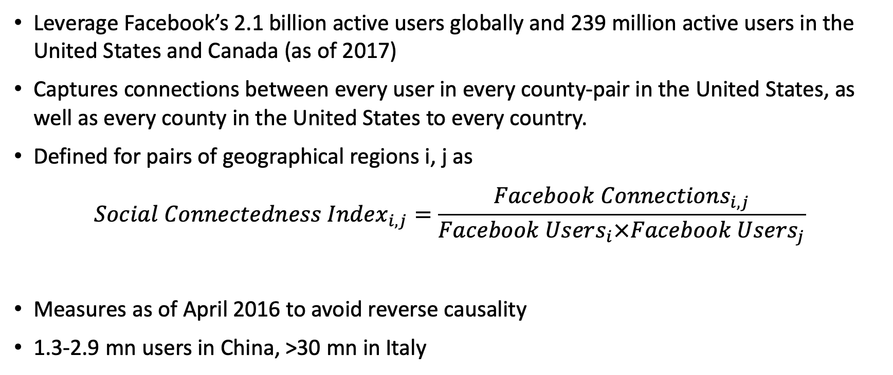
Facebook
Leverage Facebook’s 2.1 billion active users globally and 239 million active users in the United States and Canada (as of 2017)
Captures connections between every user in every county-pair in the United States, as well as every county in the United States to every country.
Defined for pairs of geographical regions i, j as
$$Social Connectedness Index_{i,j}=\frac{Facebook Connections_{i,j}}{Facebook Users_{i}×Facebook Users_{j}}$$
Measures as of April 2016 to avoid reverse causality
1.3-2.9 mn users in China, >30 mn in Italy

Slide 9
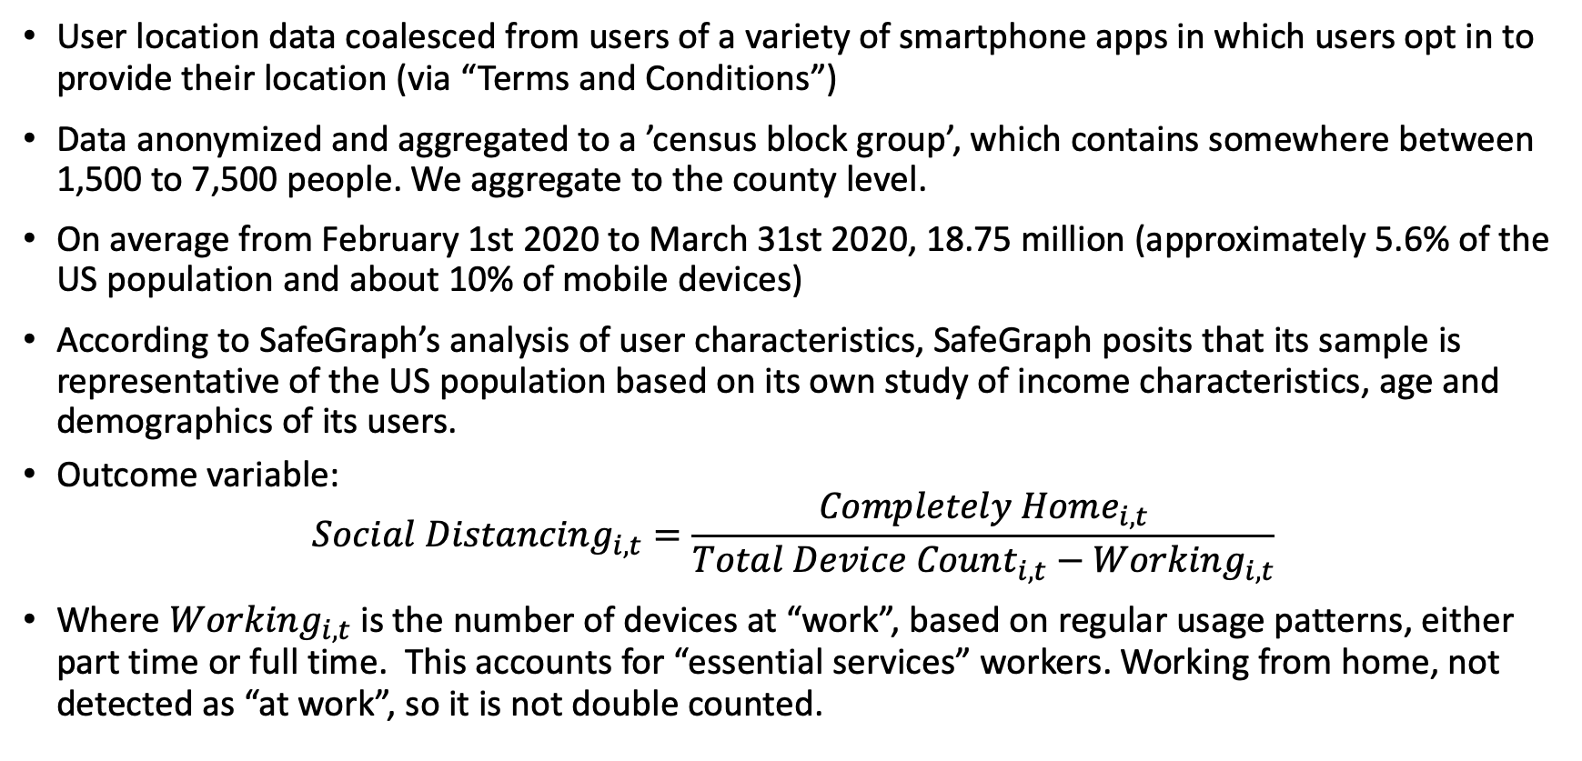
SafeGraph
User location data coalesced from users of a variety of smartphone apps in which users opt in to provide their location (via “Terms and Conditions”)
Data anonymized and aggregated to a ’census block group’, which contains somewhere between 1,500 to 7,500 people. We aggregate to the county level.
On average from February 1st 2020 to March 31st 2020, 18.75 million (approximately 5.6% of the US population and about 10% of mobile devices)
According to SafeGraph’s analysis of user characteristics, SafeGraph posits that its sample is representative of the US population based on its own study of income characteristics, age and demographics of its users.
Outcome variable:
$$Social Distancing_{i,t}=\frac{Completely Home_{i,t}}{Total Device Count_{i,t}−Working_{i,t}}$$
Where $Working_{i,t}$ is the number of devices at “work”, based on regular usage patterns, either part time or full time. This accounts for “essential services” workers. Working from home, not detected as “at work”, so it is not double counted.

Slide 10
Stanford Crowdsourced Mobility Restriction Data
State-level policy appears complete
  As of March 30, 2020: every state closed schools
    43 states closed public places
    36 states have stay-at-home orders
    11 states ban non-essential services
Where there is no state-wide policy, we use crowdsourced county-level policy
Considered KeyStone Strategy, but at the time it seemed less complete as of April 3, 2020. (350 counties, but thousands appeared missing)
  Their data was updated April 15, 2020, but we have not re-evaluated it then. From the site: “350 US Counties Covered as of 4/15/2020 (additions in progress).”
  Not clear what is the rule for addition, or time lag in addition.

Slide 11
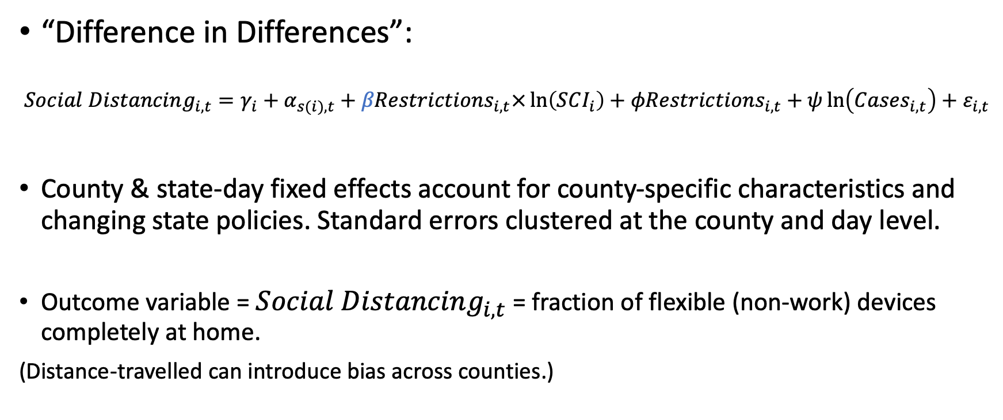
Empirical Specification
“Difference in Differences”:
$$Social Distancing_{i,t}=γ_{i}+α_{s(i),t}+βRestrictions_{i,t}×\ln\left(SCI_{i}\right)+φRestrictions_{i,t}+ψ\ln\left(Cases_{i,t}\right)+ε_{i,t}$$
County & state-day fixed effects account for county-specific characteristics and changing state policies. Standard errors clustered at the county and day level.
Outcome variable = $Social Distancing_{i,t}$ = fraction of flexible (non-work) devices completely at home.
(Distance-travelled can introduce bias across counties.)

Slide 12
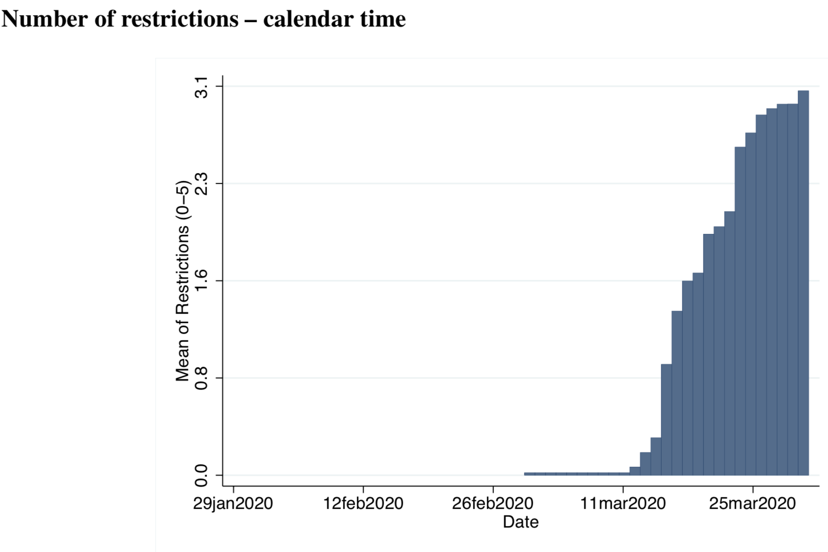
Variation in restriction is clustered towards end of the sample period (and our results are robust to excluding February.)

Slide 13
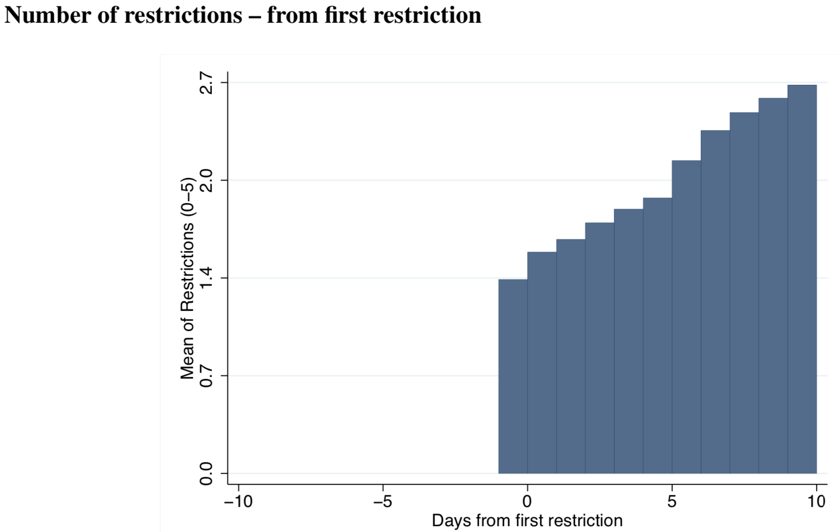
Variation in restriction is both along the intensive margin and extensive margin (and our results are robust to using only extensive margin, looking at first restriction.)

Slide 14
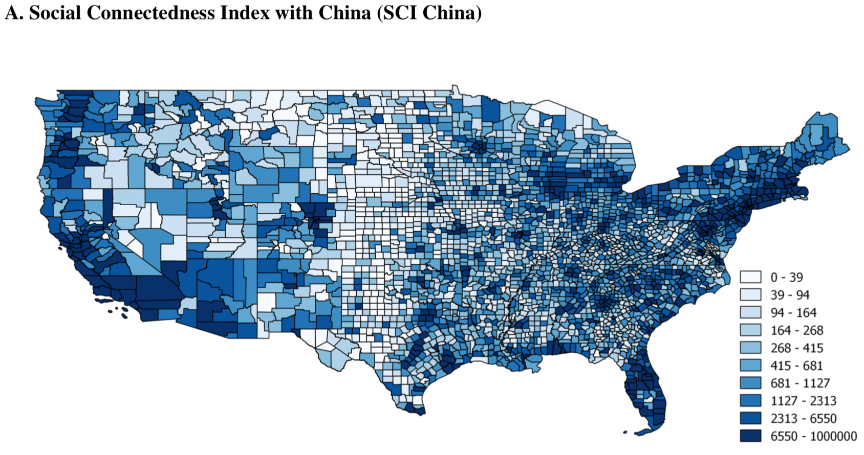
Correlation of Italy and China SCI = 0.948

Slide 15
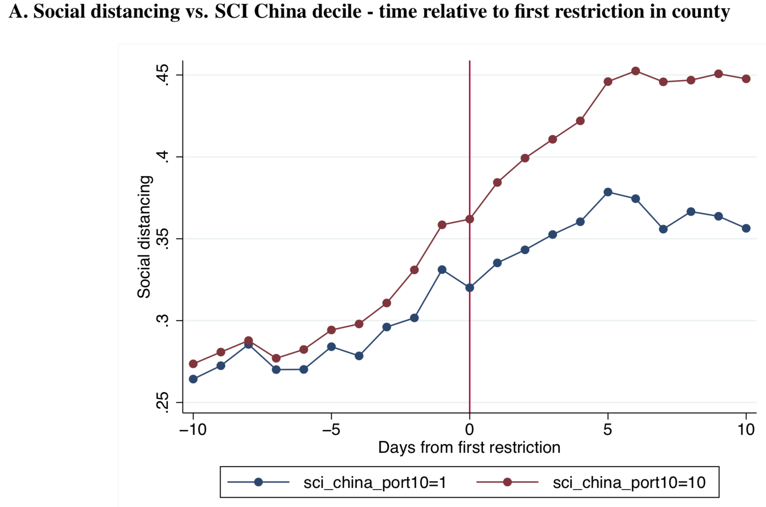
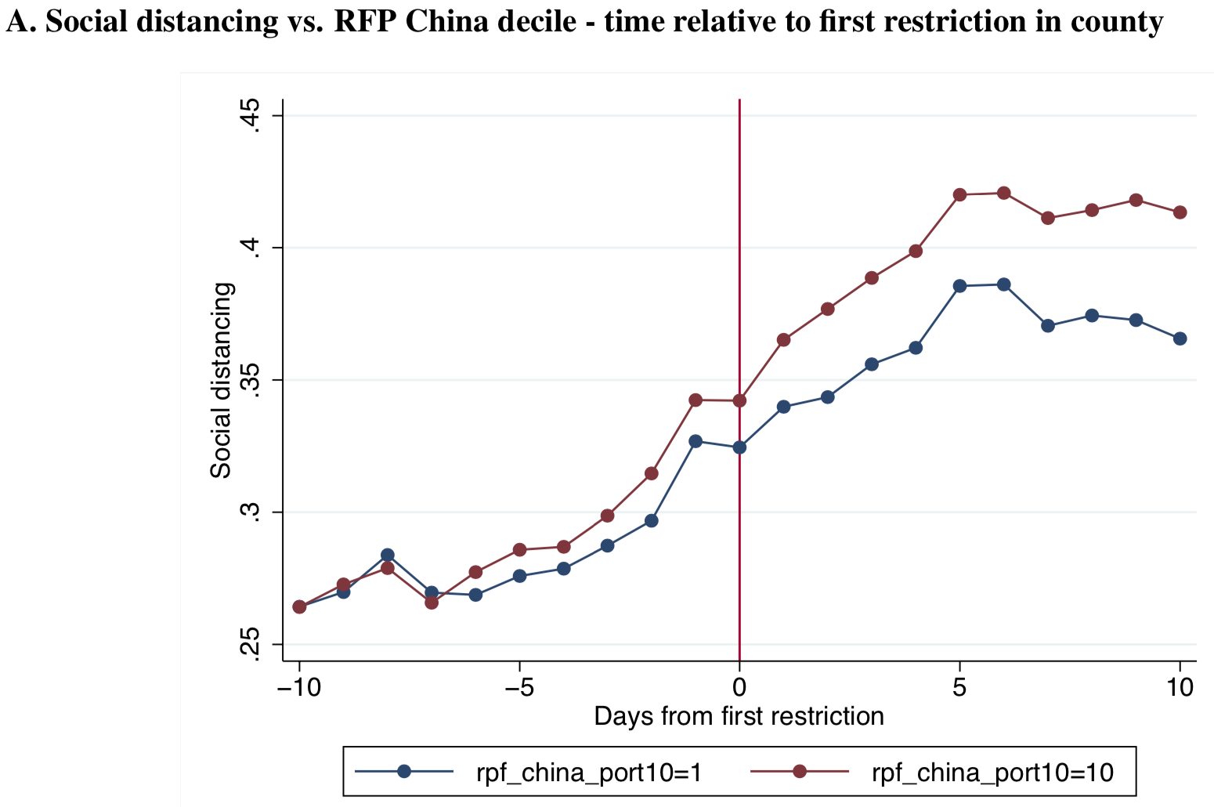
Counties with more social connections with China respond more to mobility restrictions (very similar picture for Italy)
Plots below are raw event-time plots with no controls.
Log(Social Connection Index) Relative Friend Probabilities

Slide 16
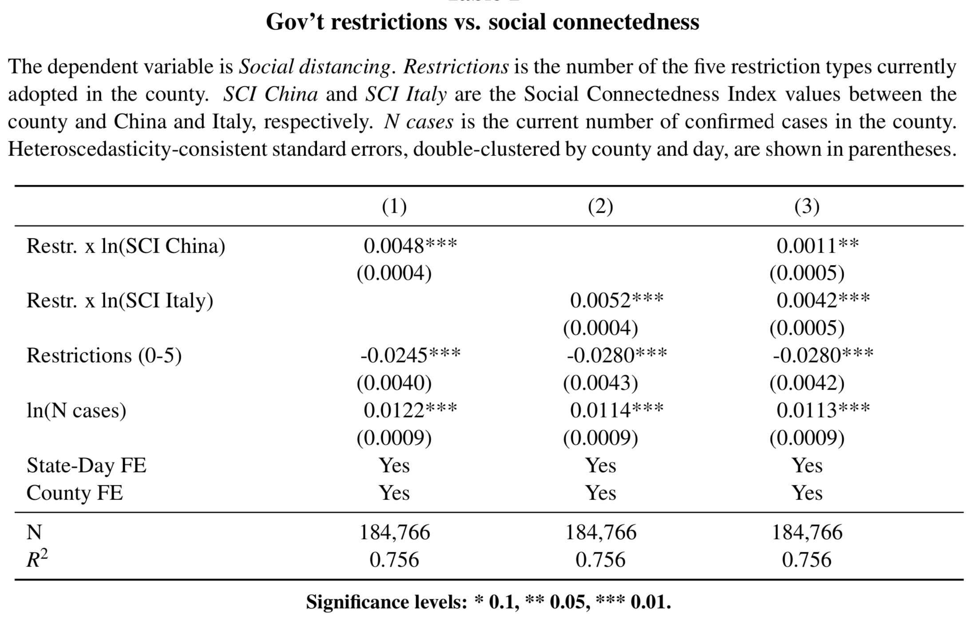

Slide 17
Distinguishing alternative hypotheses
Limitations: lots of unobserved heterogeneities within a county,
but the ideal experiment is privacy-invasive.
  For example: Suppose Ben, Alan, and Vesa are in different counties
    Ben receives fb messages & posts about his friends from China visiting → risk exposure
    Alan receives fb messages & posts about “Chinese” virus → biased beliefs
    Vesa receives fb messages & posts about pandemic severity in Italy → information
However, we can…
  See if high-health-risk counties respond more to social connections
  (testing the risk hypothesis)
  See if political ideology or race alignment respond more to social connections
  (testing the biased beliefs hypothesis)
  See if less-sophisticated counties respond more to social connections
  (testing the information hypothesis)

Slide 18
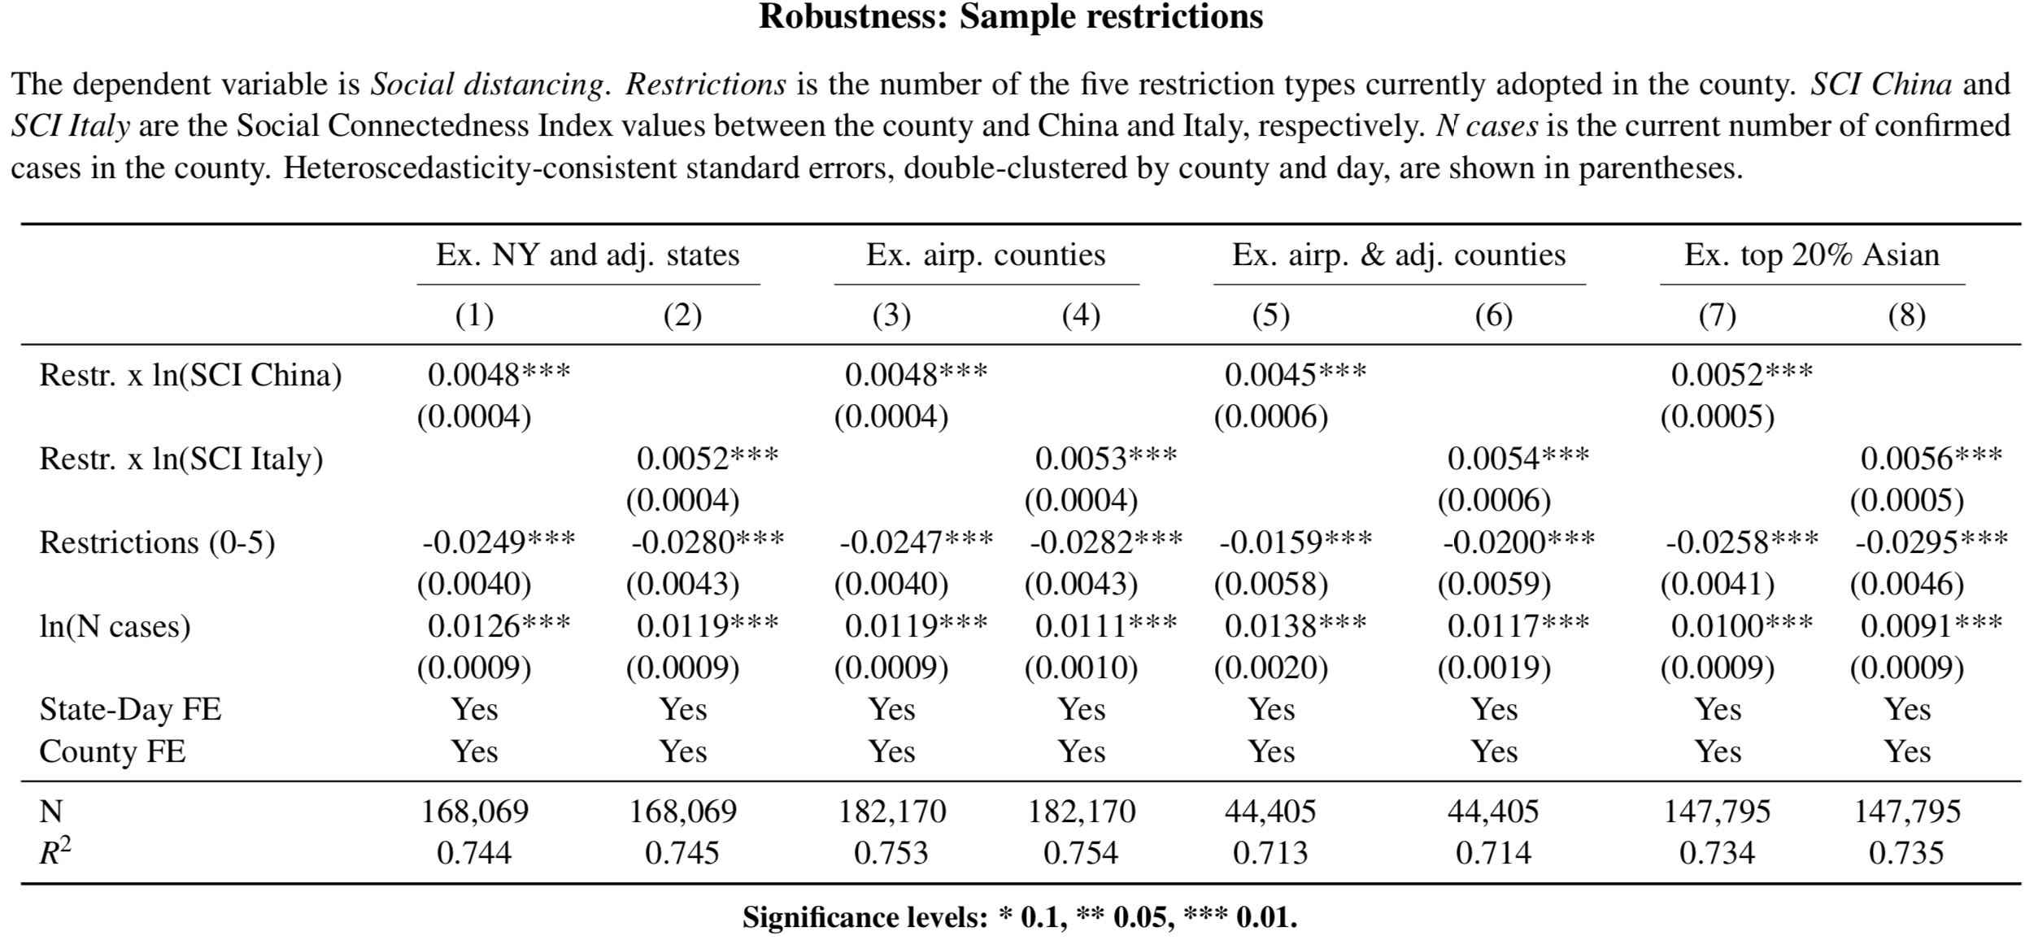
Risk Exposure: Doesn’t seem to be due to travel or Asians.

Slide 19
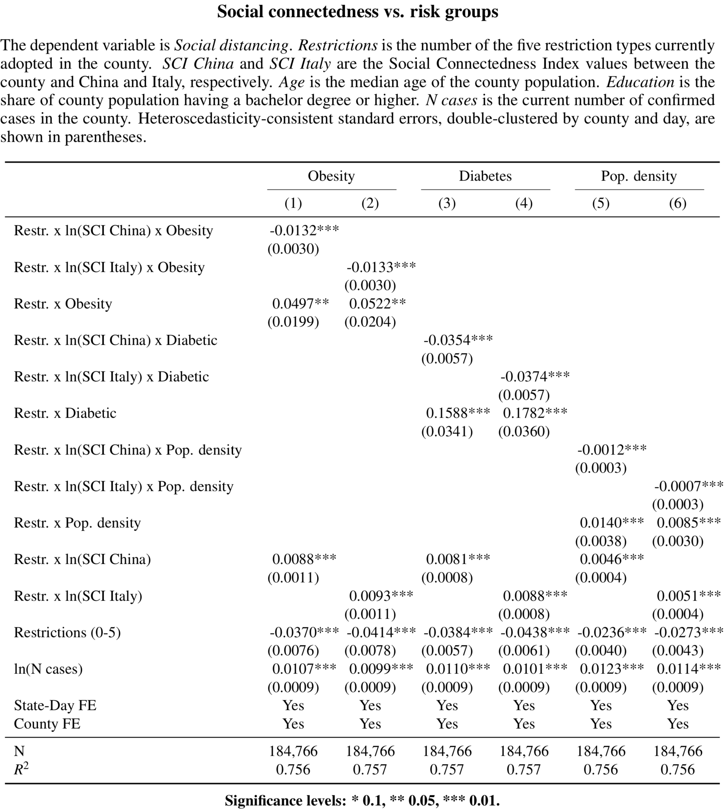
Risk Exposure:
Lower social connection effect in areas with more
health risk exposure.
More health risk, more compliance overall.
Effect of social connections still present unconditionally.

Slide 20
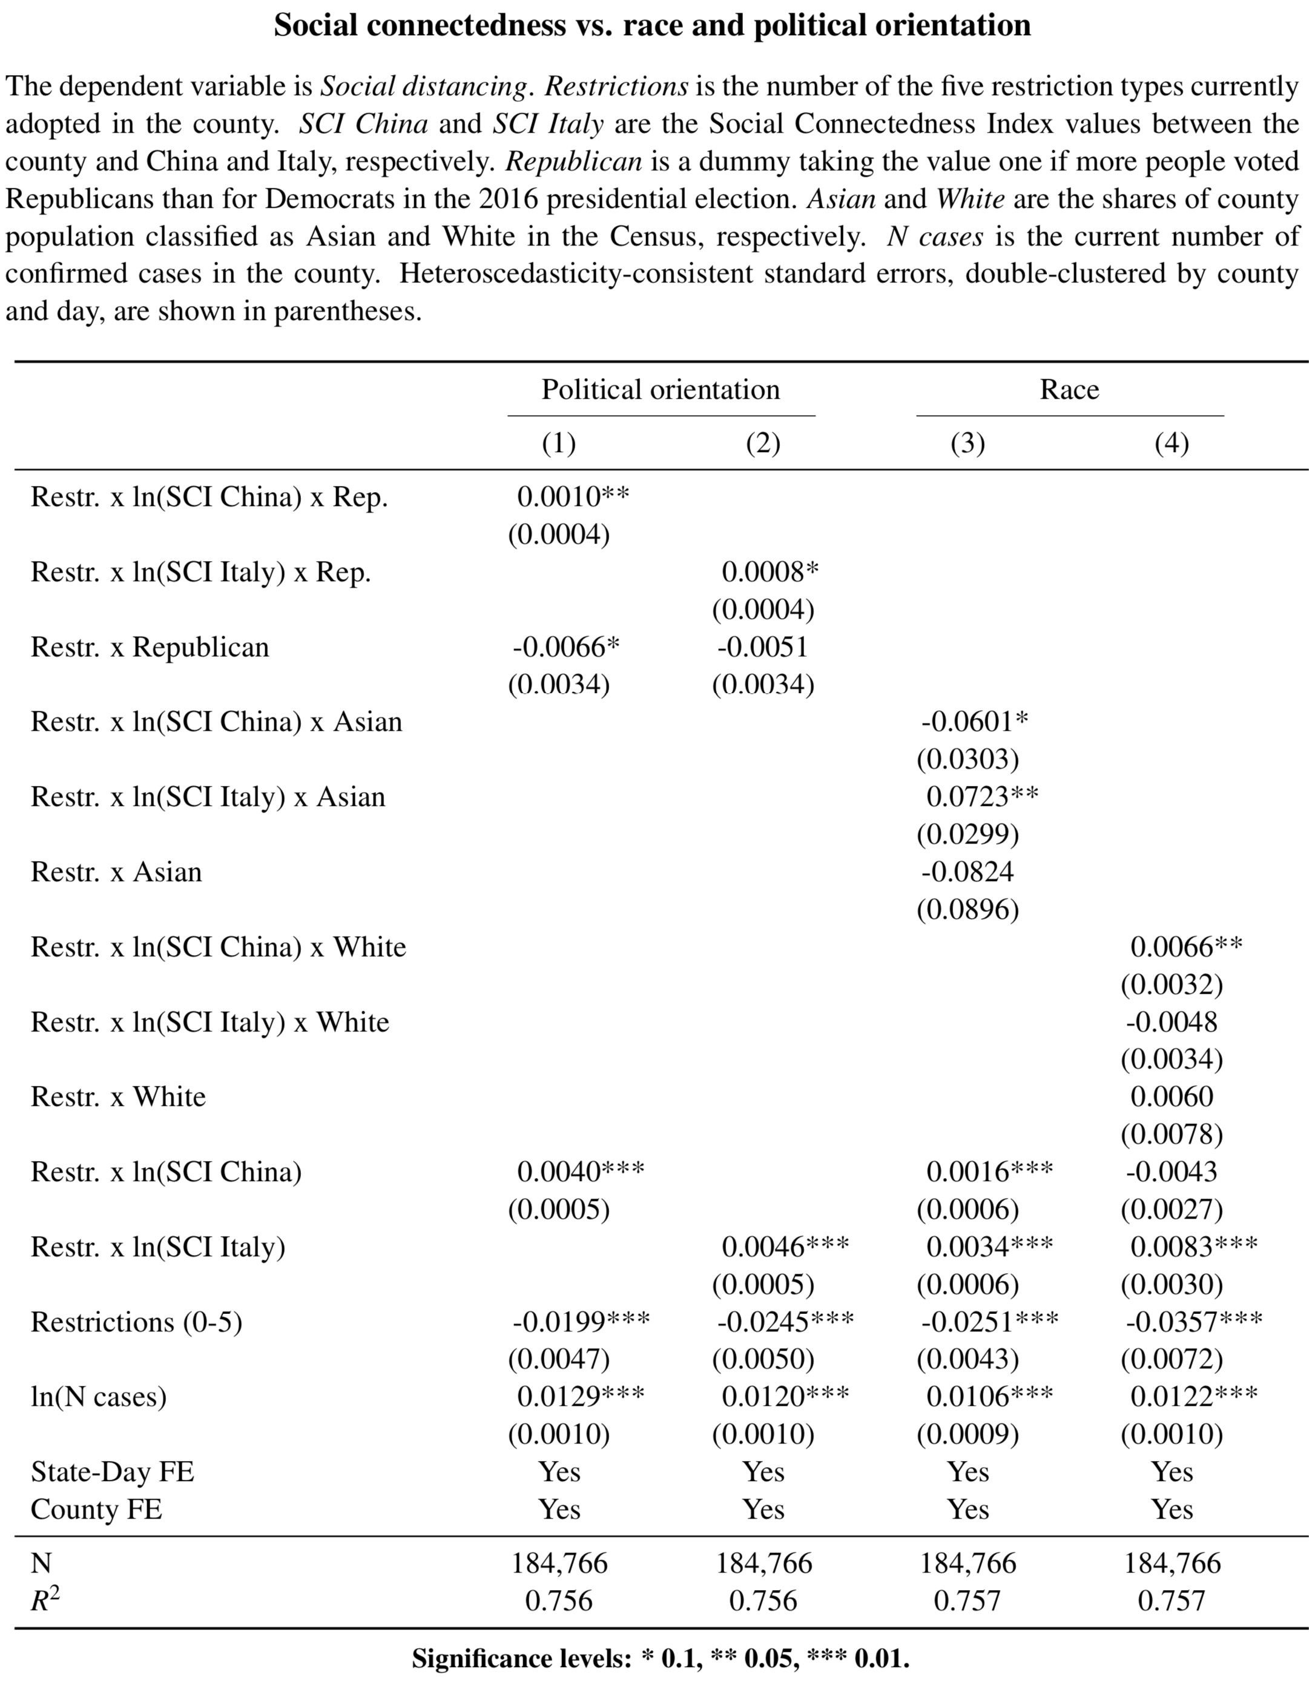
Biased Beliefs:
Using Political Orientation and Race, we find:
(Column 1) Republican w/ friends in China → more SCI effect
(Column 2) Republican w/ friends in Italy → more SCI effect
(Column 3) Asian w/ friends in Italy → more SCI effect
(Column 3) Asian w/ friends in China → less SCI effect
(Column 4) White w/ friends in China→ more SCI effect
(Column 4) White w/ friends in Italy→ less SCI effect
Opposite of the echo chamber hypothesis
Notes:
Economic Magnitude: 105% increase in compliance for republicans and 85% increase for dems.

Slide 21
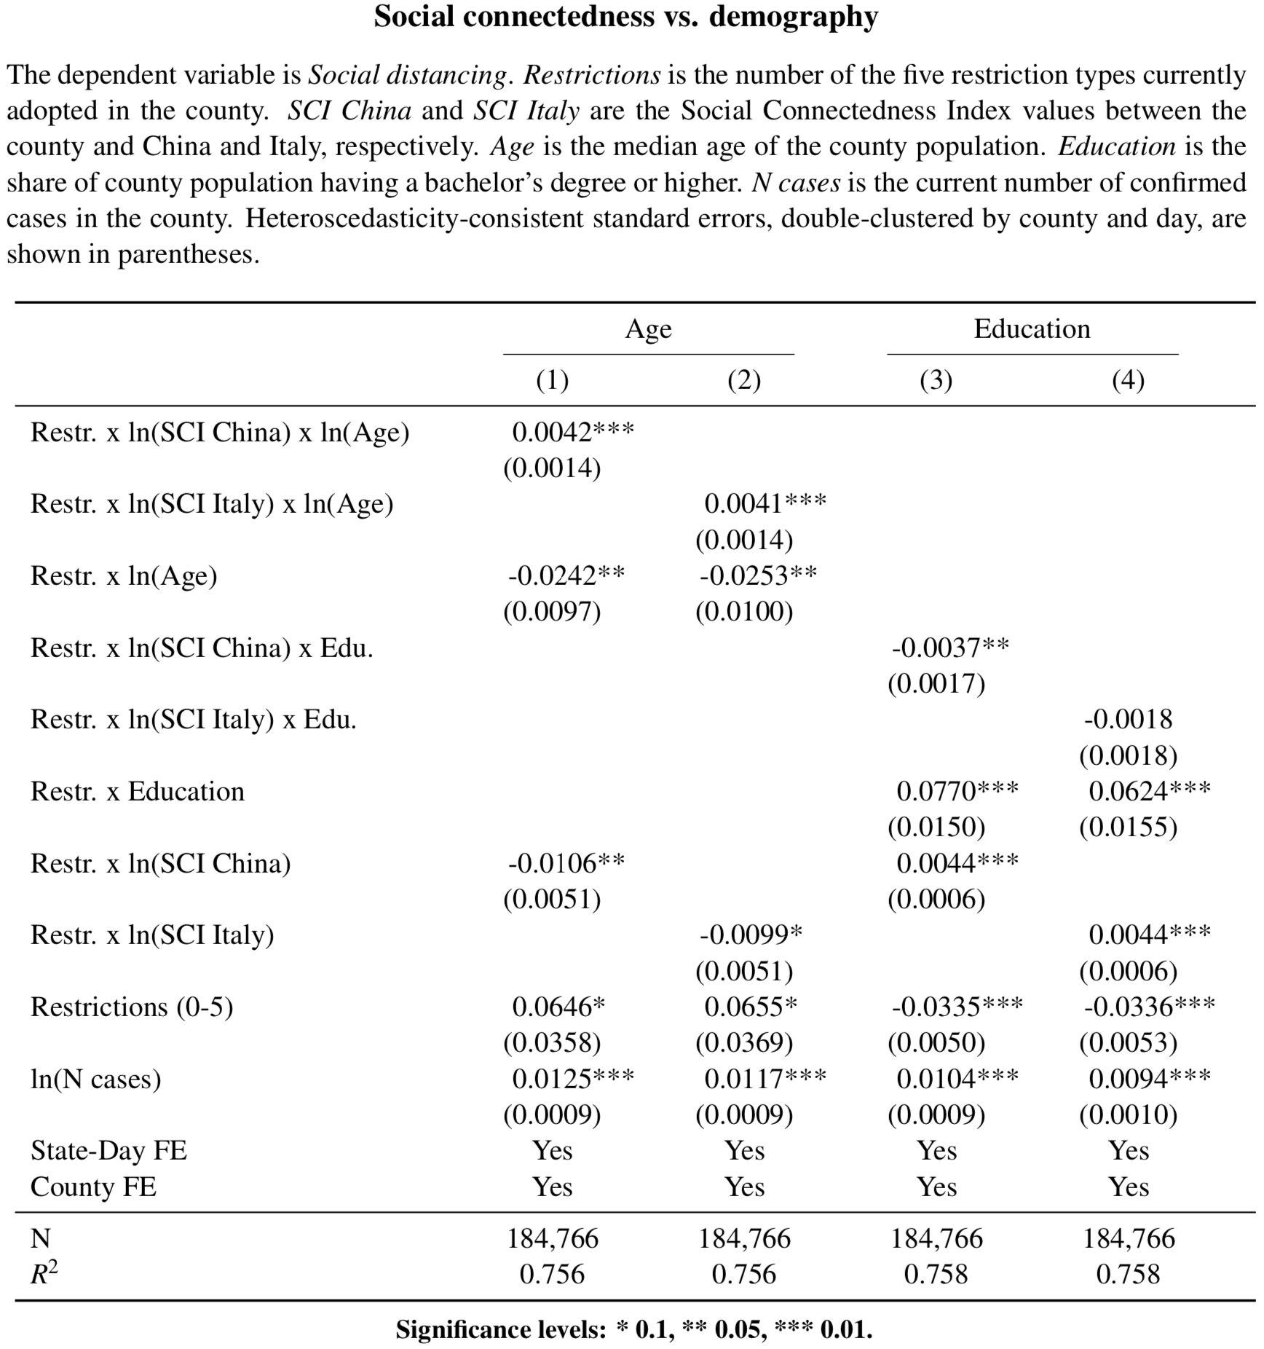
Information Flow:
Column (1 & 2)
Older counties exhibit more social connection effect
Column (3 & 4)
Better-educated counties exhibit a smaller social connection effect
Notes:
Ranking loosely based on geographical distance.

Slide 22
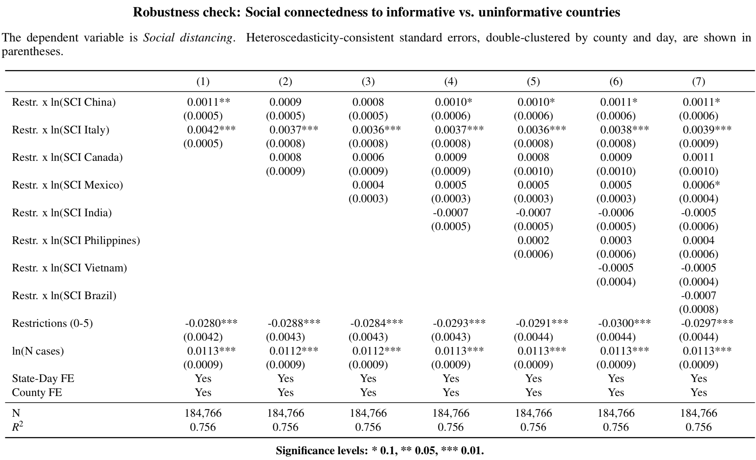
Information Flow: Social connection effect appears only for Italy and China and not other affected and geographically closer countries.
Notes:
Ranking loosely based on geographical distance.

Slide 23
Conclusion
Do people in the U.S. learn from the experiences of social connections in China or Italy?
  Yes. Social connections to Italy and China increase the efficacy of mobility restrictions imposed by local governments by around 50% relative to the unconditional effect
  Amplification appears due to information channel rather than risk exposures or biased beliefs
Results can be used to guide allocation of public health officials / law enforcement to better monitor or enforce compliance with social distancing.

Slide 24
Appendix:
Intra-US connections
SCI-based amplification of local threats
Results split by types of mobility restrictions

Slide 25
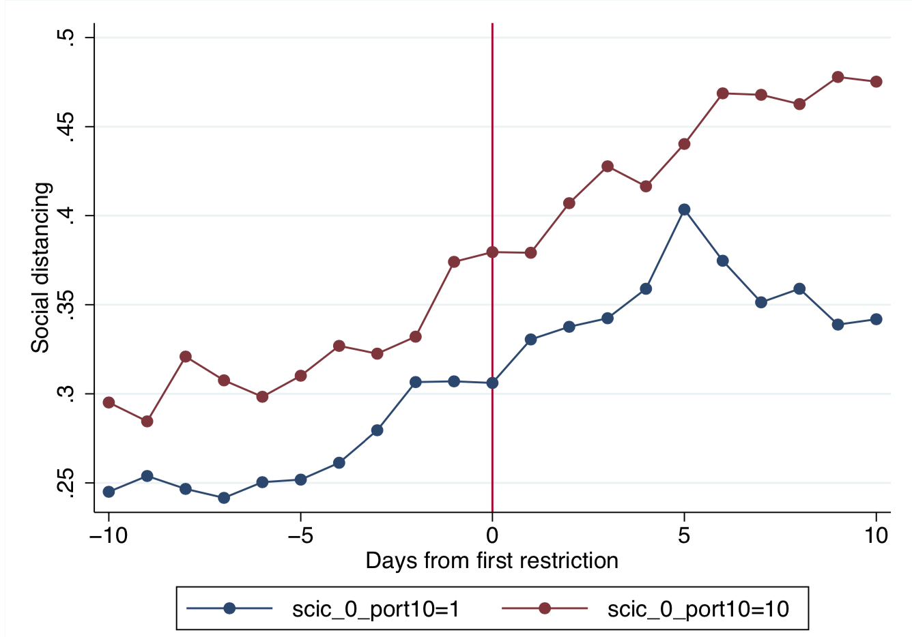
Intra-US Social Connections
Ranking social connections within the U.S., weighted by those local cases, generates similar results that we find for Italy and China.

Slide 26
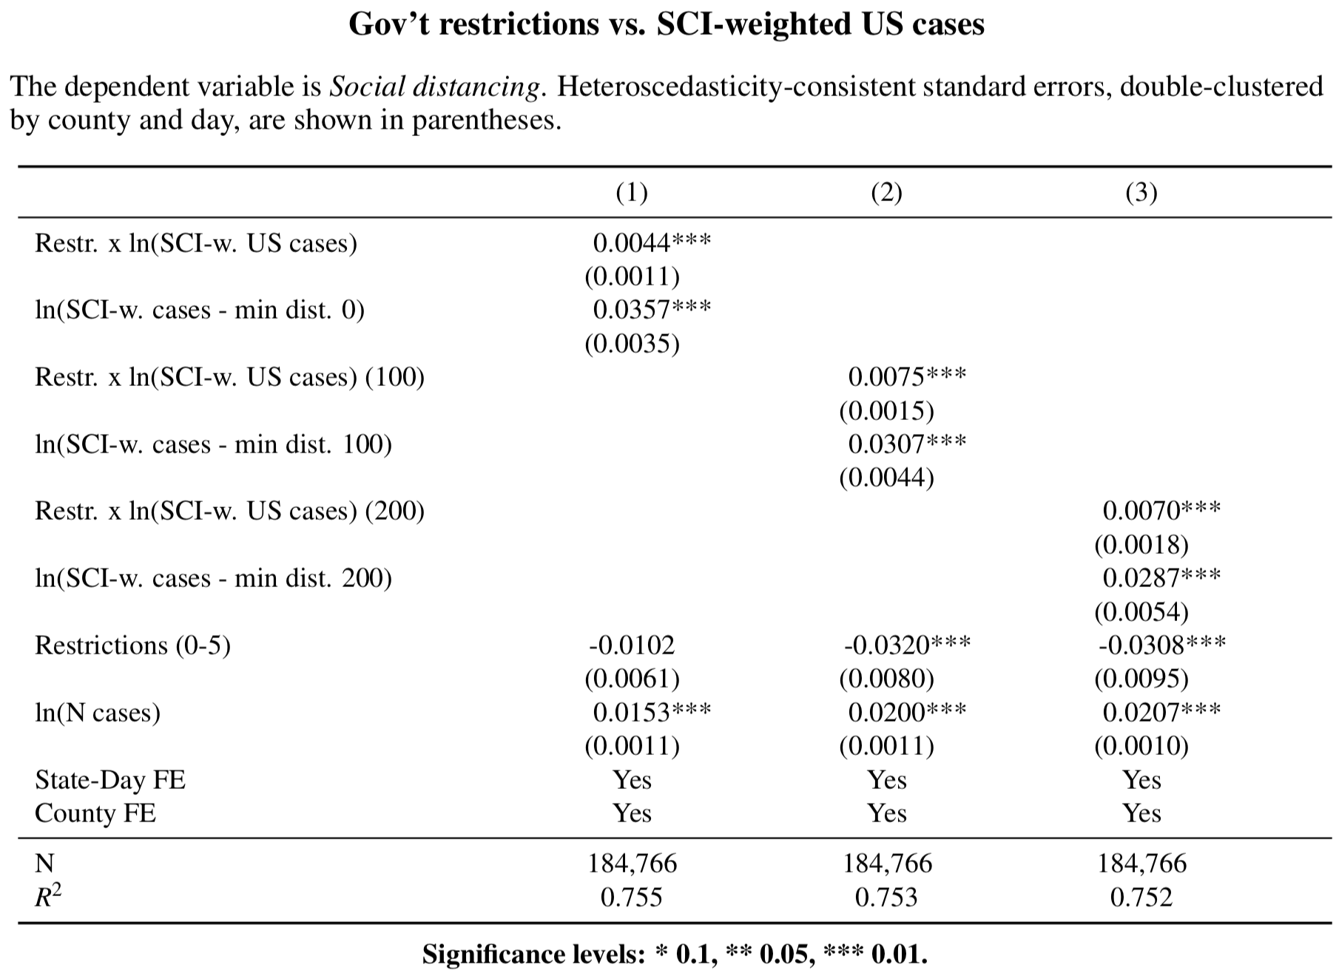
Intra-US Social Connections

Slide 27
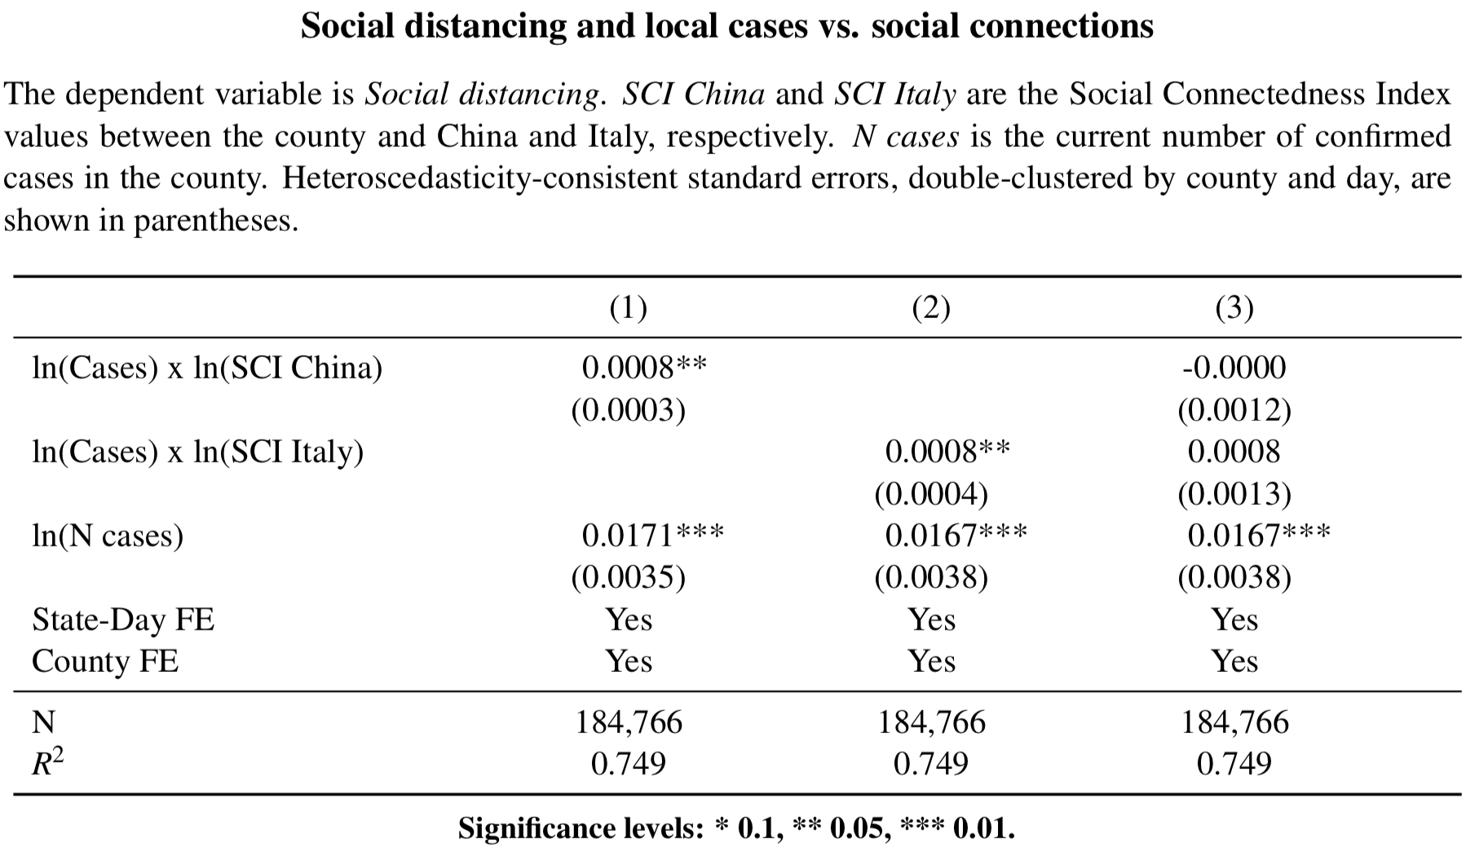
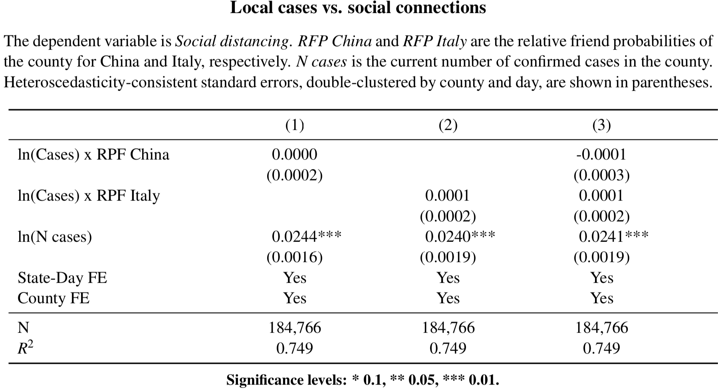
Social connections and local threats

Slide 28
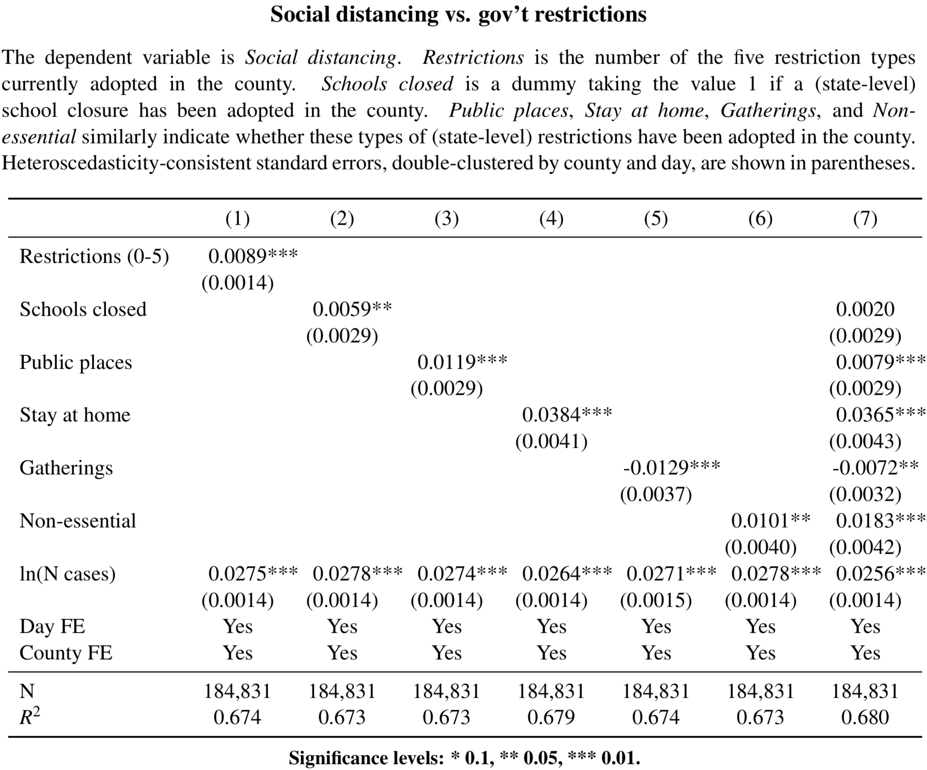
Impact of diff. mobility restrictions

Slide 29
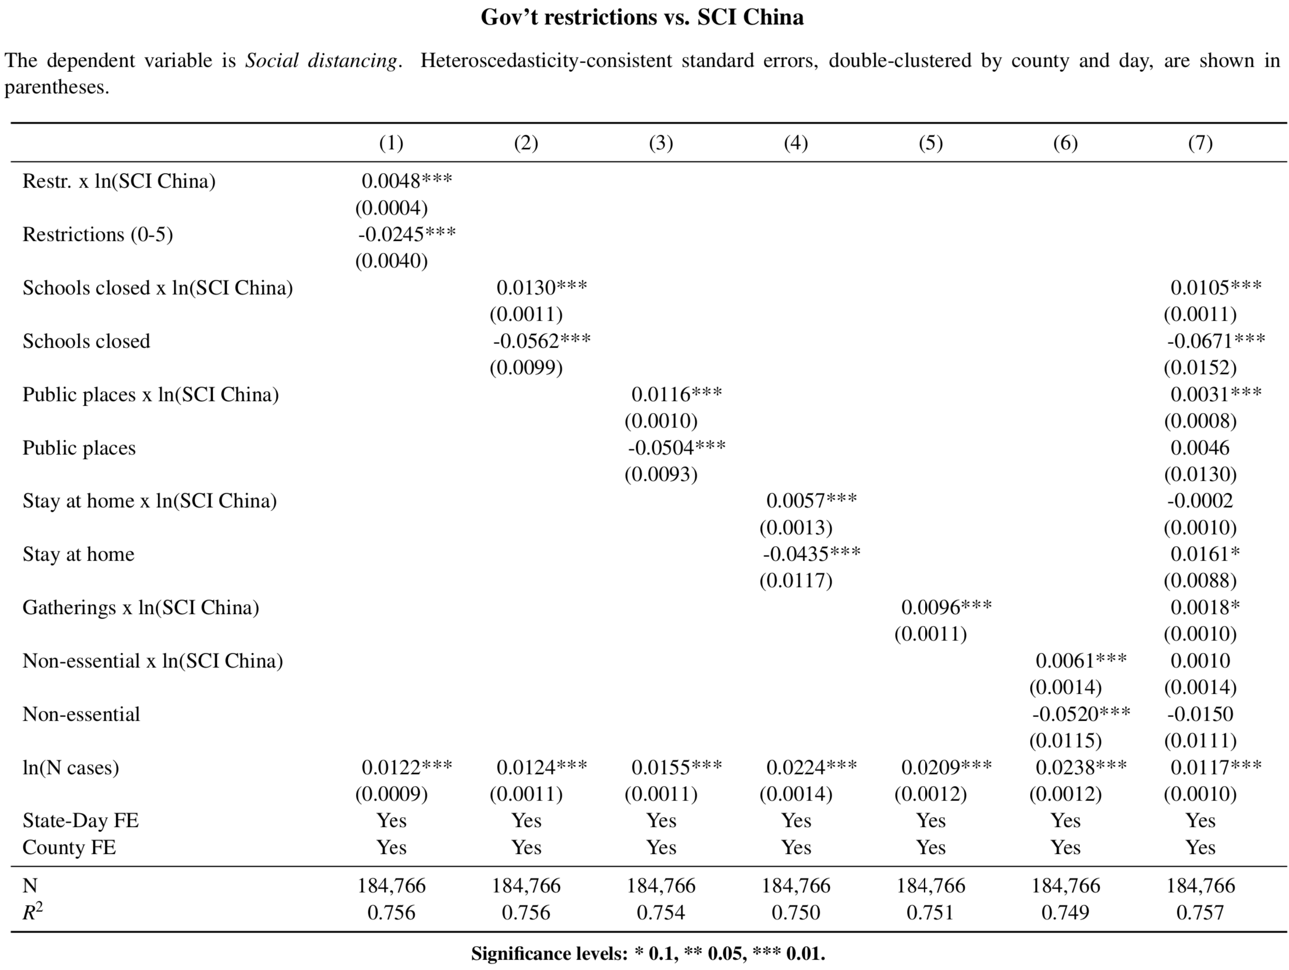
SCI & Impact of diff. mobility restrictions

